Slide 1
ALGORITHM ANALYSIS AND DESIGN
BACKTRACKING

Slide 2
A Short List Of Categories
Algorithm types we will consider include:
Simple recursive algorithms
Divide and conquer algorithms
Greedy algorithms
Dynamic programming algorithms
Backtracking algorithms
Branch and bound algorithms

Slide 3
Introduction
Backtracking is used to solve problems in which a sequence of objects is chosen from a specified set so that the sequence satisfy some criterion.

Slide 4
Backtracking- When
There is a sequence of decisions to be made, from a number of available choices, where
sufficient information is not available on the best choice
Each decision leads to a new set of choices
Some sequence of choices (possibly more than one) may be a solution to your problem

Slide 5
Backtracking- How
Backtracking is used to solve problems in which a sequence of objects is chosen from a specified set so that the sequence satisfies some criterion.
Backtracking is a modified depth-first search of a tree.
It is the procedure whereby, after determining that a node can lead to nothing but dead nodes, we go back (“backtrack”) to the node’s parent and proceed with the search on the next child.

Slide 6
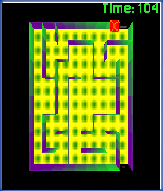
Solving A Maze
Given a maze, find a path from start to finish
At each intersection, you have to decide between three or fewer choices:
Go straight
Go left
Go right
Sufficient information not available on the best choice
Each choice leads to another set of choices
One or more sequences of choices may (or may not) lead to a solution

Slide 7
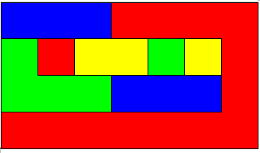
Coloring A Map
You wish to color a map with not more than four colors
red, yellow, green, blue
Adjacent countries must be in different colors
You don’t have enough information to choose colors
Each choice leads to another set of choices
One or more sequences of choices may (or may not) lead to a solution

Slide 8
Backtracking- Demonstration
dead end
?
dead end
dead end
?
start
?
?
dead end
dead end
?
success!

Slide 9
Representation
The decision sequences can be represented by a tree
Three kinds of nodes:
The (one) root node
Internal nodes
Leaf nodes
Backtracking can be thought of as searching a tree for a particular “goal” leaf node

Slide 10
Types Of Nodes
Live node
A node which has been generated, and all of its children have not yet been generated
Dead node
A generated node which is not to be expanded further or all of whose children have been generated.
E-node
The live node whose children are being generated.

Slide 11
Types Of Nodes - Demonstration
* 2:15 AM Algorithm Analysis and Design
dead end
dead end
dead end
start
dead end
Child Node
dead end
Goal Node
?
Live Node
success!
E-node
Dead Node

Slide 12
Constraints
* 2:15 AM Algorithm Analysis and Design
Explicit constraints
Rules that restrict each element to be chosen from the given set
Only tuples that satisfy explicit constraints will appear in the tree
Implicit constraints
Rules that specify how each elements in a tuple should be related
Tuples in the tree that satisfy the implicit constraints represent a goal state

Slide 13
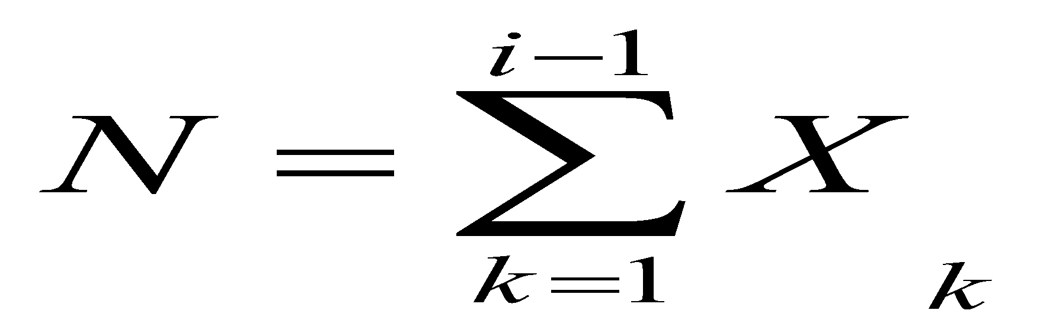
Constraints-Example
* 2:15 AM Algorithm Analysis and Design
Let x_{i} represents i th decision
Explicit constraints
Restrict the possible values of xi
Eg:- x_{i} =0 or 1; x_{i} ε {li..ui}
Implicit constraints
Specify how the different xi’s are related
Eg:- x_{i} < x_{i+1} ;

Slide 14
Solution Space
* 2:15 AM Algorithm Analysis and Design
Set of all tuples that satisfy the explicit constraints
Represented using a permutation tree- state space tree
The edges labeled by possible values of xi
Edges from level 1 to level 2 nodes specify the values for x1
Defined by all paths from the root to a leaf node

Slide 15
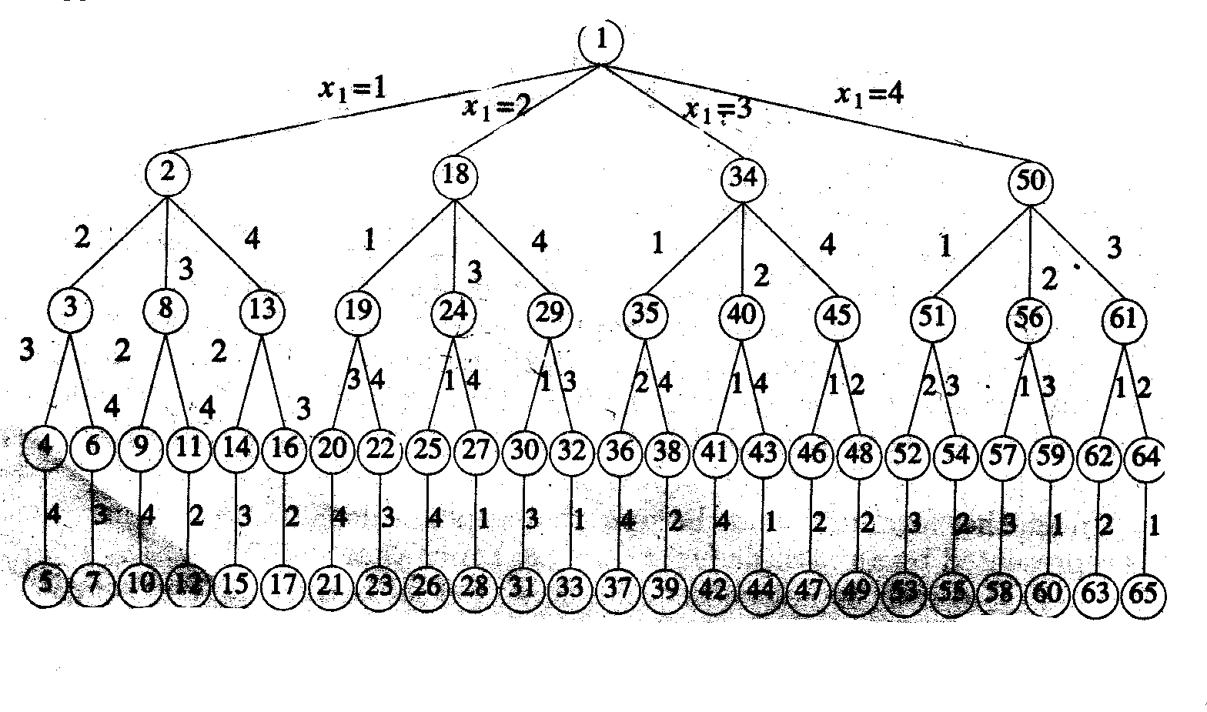
State Space Tree
* 2:15 AM Algorithm Analysis and Design

Slide 16
Solution Space Contd..
* 2:15 AM Algorithm Analysis and Design
Each level in the tree defines a problem state
Paths from root to other nodes are known as state spaces
Solution states- problem states s for which the path from the root to s defines a tuple in the solution space
Answer states - solution states s for which the path from the root defines a solution from the set of solutions

Slide 17
State Space Tree -Organization
* 2:15 AM Algorithm Analysis and Design
A problem can be specified in 2 ways
Fixed tuple formulation
The state space organization is called static trees
Variable tuple formulation
State space tree of this type is known as dynamic tree

Slide 18
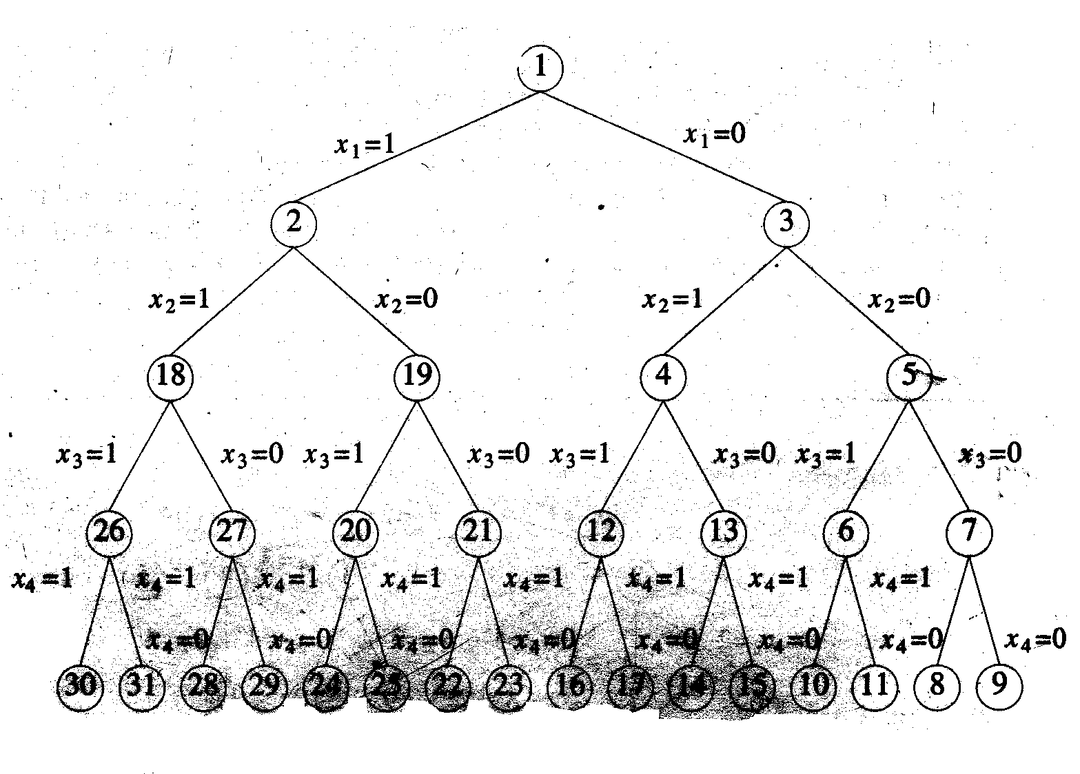
Fixed Tuple Formulation
* 2:15 AM Algorithm Analysis and Design
Edges from level i nodes to level i+1 nodes are labeled with the value of xi, which is either 0 or 1
All paths from root to leaf node define the solution space

Slide 19
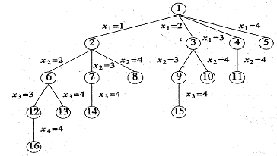
Variable Tuple Size Formulation
* 2:15 AM Algorithm Analysis and Design
Size of solution tuples is not fixed.
Each tuple will contain a subset of the xi’s in the order in which they are included instead of specifying xi=0 or 1.

Slide 20
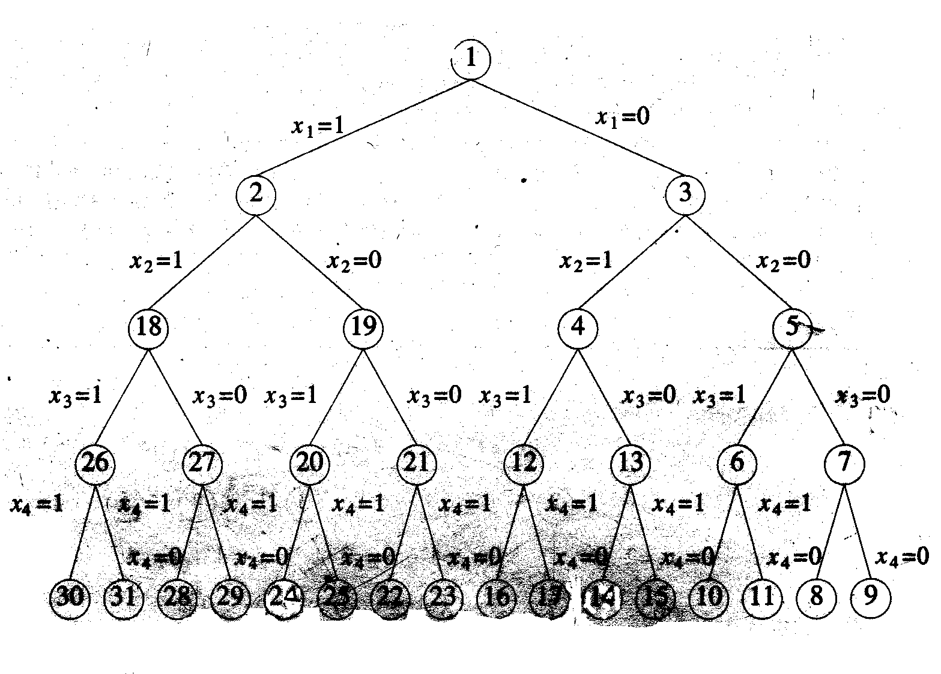
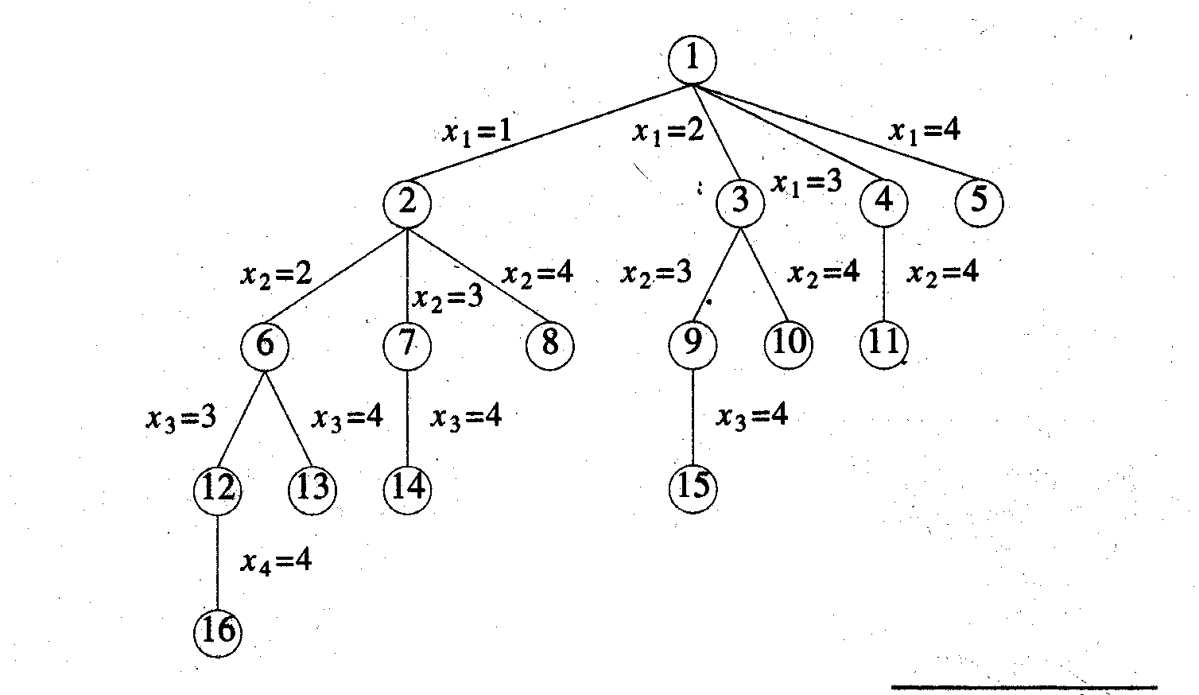
Comparison
* 2:15 AM Algorithm Analysis and Design
Fixed tuple formulation
Solution size is fixed
Only the leaf nodes can be solution states
Variable tuple formulation
Solution size is variable
Any intermediate node can be the solution state
<1,0,1,1>
<0,1,0,1>
<2,4>
<1,3,4>
Notes:
*
20
path 1,2,19,20,25 fig1 and 1,2,7,14 in fig2
path 1,3,4,13,15 fig1 and 1,3,10 in fig2

Slide 21
Solving The Problem
* 2:15 AM Algorithm Analysis and Design
Fix a state space tree organization
Systematically generate the problem states starting from the root
Verify each problem state whether it is a solution state or an answer state

Slide 22
State Space Tree Generation
* 2:15 AM Algorithm Analysis and Design
Backtracking uses depth first generation of the state space tree with some bounding function
Bounding functions are used to kill live nodes without generating all their children
Killing should be done after ensuring that all the required answer states are generated

Slide 23
The Backtracking Algorithm
* 2:15 AM Algorithm Analysis and Design
Backtracking algorithm is quite simple
it requires “exploring” each node, as follows:
To “explore” node N:
1. If N is a goal node, return “success”
2. If N is a leaf node, return “failure”
3. For each unbounded child C of N,
3.1. Explore C
3.1.1. If C is successful, return “success”
4. Return “failure”

Slide 24
Backtracking -Impementation
* 2:15 AM Algorithm Analysis and Design
Generating Function
Generate next child, given the parent
Bounding function
Check whether the particular path can lead to an answer state and returns false If it cannot.

Slide 25
Control Abstraction
* 2:15 AM Algorithm Analysis and Design
Algorithm backtrack(n)
{k=1;
while (k#0) do
{
if (there remains an untried x[k] ε T(x[1],x[2],. . . ,x[k-1]) and B_{k}(x[1],x[2], . . .,x[k]) is true) then
{
if x[1]. …x[k] is a path to an answer node) then write x[1:k]);
k:=k+1;}
else k:=k-1;}}

Slide 26
Recursive Formulation
* 2:15 AM Algorithm Analysis and Design
Algorithm Backtrack(k)
//This schema describes the backtracking process using
//recursion. On entering, the first k-1 values
//x[1],x[2],….,x[k-1] of the solution vector
//x[1 : n] have been assigned. x[] and n are global.
{ for (each x[k] ε T(x[1],……,x[k-1]) do
{if(B_{k} (x[1],x[2],……x[k] ≠ 0 ) then
{if(x[1],x[2],….,x[k] is a path to an answer node)
then write (x[1 : k]);
if(k < n) then Backtrack(k + 1);}}}

Slide 27
Efficiency Of Backtracking
* 2:15 AM Algorithm Analysis and Design
Time taken to generate next x_{k}
Number of x_{k} satisfying the explicit constraints
Time required for computing the bounding function
A bounding function is said to be good if it reduces the number of nodes drastically.
A good bounding function may take much computing time
Number of x_{k} satisfying b_{k}
Trade off between the number of nodes removed and computing time requirement.
The ultimate aim is to reduce the total time requirement

Slide 28
Analysis
* 2:15 AM Algorithm Analysis and Design
For some problem instances, if the order of generation of children is changed, the number of nodes to be generated before finding the solution can be drastically reduced.
Depending on the problem instance, the backtracking algorithm will generate O(n) nodes to n! nodes.
The importance of backtracking lies in its ability to solve some instances with large n in a very small amount of time.

Slide 29
4 Queens Problem
* 2:15 AM Algorithm Analysis and Design
There are 4 queens that are
to be placed on a
4x4 chessboard
Queens should be placed on the
chessboard such that
no two queens can attack each other.
Two queens attack each other when they are in the
Same row
Same column or
Same diagonal.

Slide 30
Attacking Positions
* 2:15 AM Algorithm Analysis and Design
Two queens attack each other when they are in the
Same row
Same column or
Same diagonal.
۩
۩
۩
 |  | *
۩
۩
۩
۩
۩
۩
۩
۩
۩
۩
۩
۩
۩
۩
۩
۩
۩
Rule 1
Rule 2
Rule 3.a.
Rule 3.b.

Slide 31
Problem Specification
* 2:15 AM Algorithm Analysis and Design
The queens are numbered from 1 to 4.
Rows and columns in the chess board are also numbered from 1 to 4.
Each row can contain exactly one queen.
So it is assumed that queen i is placed in row i.
1 2 3 4
Queen 1 is placed in row 1
1 2 3 4
Queen 2 is placed in row 2
Queen 3 is placed in row 3
Queen 4 is placed in row 4

Slide 32
Solution Space
* 2:15 AM Algorithm Analysis and Design
The solution space consists of 4⁴ 4 tuples.
The implicit constraint
no two queens are in the same column
No two xi’s can be the same
no two queens can be on the same diagonal.
Column constraint restricts the solution space to consist of combinations of 4 tuples.
So the solution space gets reduced to 4! Tuples.
Second constraint specify that no two xi’s should be on the same diagonal.

Slide 33
Solution Space
* 2:15 AM Algorithm Analysis and Design
Number of tuples generated after considering column constraint - 4! Tuples

Slide 34
Problem State-representation
* 2:15 AM Algorithm Analysis and Design
1
 |  |  | 2
∙ | 3
Queen i is represented by the number i
∙ represents an unsuccessful attempt

Slide 35
4 Queens Problem- Tree Formation
* 2:15 AM Algorithm Analysis and Design
1
1
1
1
1
2
2
2
2
2
2
2
2
1
1
1
2
2
2
3
•
3
•
•
.
•
.
•
.
3
1
1
1
1
2
2
2
2
3
3
3
3
•
.
.
.
.
4
•
•
•
4
4
4
4

Slide 36
4 Queens - Formation Of Solution
* 2:15 AM Algorithm Analysis and Design
1
1
1
1
2
2
2
.
.
.
.
3
1
1
1
1
2
.
.
.
2
2
3
3
.
.
.
.
.
.
4

Slide 37
N Queens Problem
* 2:15 AM Algorithm Analysis and Design
Queens problem can be generalized to n queens problem.
N queens
N X N chess board
Solution a sequence of n decisions

Slide 38
Bounding Function
* 2:15 AM Algorithm Analysis and Design
The bounding function should return a value true if the current queen can be placed at a particular position.
i^{th} queen can be placed at position k if none of the previous queens are in the same column or in the same diagonal.
Same column verification by checking whether xi=k for all previous queens.

Slide 39
Same Diagonal Verification
* 2:15 AM Algorithm Analysis and Design
QUEENS at (i,j) and (k,l)
same forward diagonal if i-j=k-l or j-l = i-k (1)
same backward diagonal if i+j=k+l or j-l = k-i (2)
combining 1&2 we can write
|j - l |= |i – k|
so two queens lies on the same diagonal if and only if
|j - l |= |i – k|

Slide 40
Formation Of Bounding Function
* 2:15 AM Algorithm Analysis and Design
same column verification by checking whether xi=k for all previous queens.
so two queens lies on the same diagonal if and only if
|j - l |= |i – k|
Each queen j,x[j] with queen(i,k)
if ((x[j]=i) or (abs(x[j]-i)= abs(j-k) ))

Slide 41
Bounding Function -Place
* 2:15 AM Algorithm Analysis and Design
Each queen j,x[j] with queen i,k
if ((x[j]=i) or (abs(x[j]-i)= abs(j-k) ))
Algorithm place(k,i)
{
for j:=1 to k-1 do
if ((x[j]=i) or (abs(x[j]-i)= abs(j-k) ))
then return false;
return true;
}

Slide 42
Algorithm
* 2:15 AM Algorithm Analysis and Design
Algorithm nqueens(k,n)
{ for i:=1 to n do
{if place(k,i) then
{x[k]:=i;
if (k=n) then write(x[1..n]);
else nqueens(k+1,n);
}}}

Slide 43
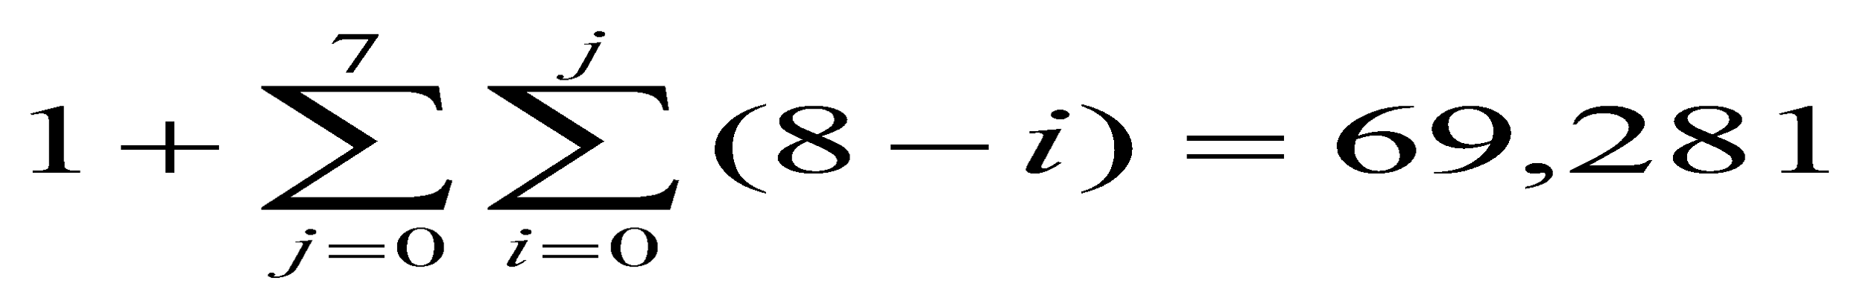
Complexity
* 2:15 AM Algorithm Analysis and Design
The number of 8 tuples generated considering placement of queens in distinct rows and columns is 8!.
Estimated number of nodes in the state space tree
1+8+8*7+8*7*6+ - - =

Slide 44
Complexity Contd..
* 2:15 AM Algorithm Analysis and Design
In practice the number of nodes generated will be very very less than this.
From Experiments it is seen that it will be approximately 3% on the average.

Slide 45
Sum Of Subsets
* 2:15 AM Algorithm Analysis and Design
Given n positive numbers/weights
Find the combinations of numbers whose sums are m.

Slide 46
Sum Of Subsets - Example
* 2:15 AM Algorithm Analysis and Design
n=6 {w1,w2,………..w6}
= {5,10,12,13,15,18}
m = 30
Solution {5,10,15}
{5,12,13}
{12,18}

Slide 47
Sum Of Subsets- Formulation
* 2:15 AM Algorithm Analysis and Design
Numbers are arranged and considered in the non decreasing order.
It can be formulated in 2 ways.
In fixed tuple each xi=0 or 1
In variable tuple xi=1..n depending on the next number selected.
In fixed tuple formulation the state space tree

Slide 48
State Space Tree Fixed Tuple Formulation
* 2:15 AM Algorithm Analysis and Design
X2=1

Slide 49
State Space Tree Variable Tuple Formulation
* 2:15 AM Algorithm Analysis and Design
X1=1
X1=4
X1=2
X1=3
X2=2
X2=4
X2=4
X2=4
X2=3
X2=3
X3=3
X3=4
X3=4
X3=4
X4=4

Slide 50
Formation Of Bounding Function
* 2:15 AM Algorithm Analysis and Design
Example: {w1,w2,………..w6} = {5,10,12,13,15,18} & m= 30
X1=1
X1=0
s : the sum of weights that have been included up to a node at level i.
r : sum of remaining weights wi+1 ,wi+2………wn
X2=1
X2=0
X2=0
X2=1
X3=1
X3=0
X3=1
X3=0
X3=1
X3=0
X3=1
X3=0
X4=1
X4=1
X4=1
X4=1
X4=1
X4=1
X4=1
X4=0
The node is nonpromising
if s+w _{i+1} > m
X4=1
X4=0
X4=0
X4=0
X4=0
X4=0
X5=0
X5=0
X5=0
X5=0
X5=0
X5=0
X5=0
X5=0
X5=0
X5=0
X5=0
X5=0
X5=0
X5=1
X5=0
X5=0
X5=1
X5=1
X5=1
X5=1
X5=1
X5=1
X5=1
X5=1
X5=1
X5=1
X5=1
X5=1
X5=1
X5=1
X5=1
if s+r < m

Slide 51
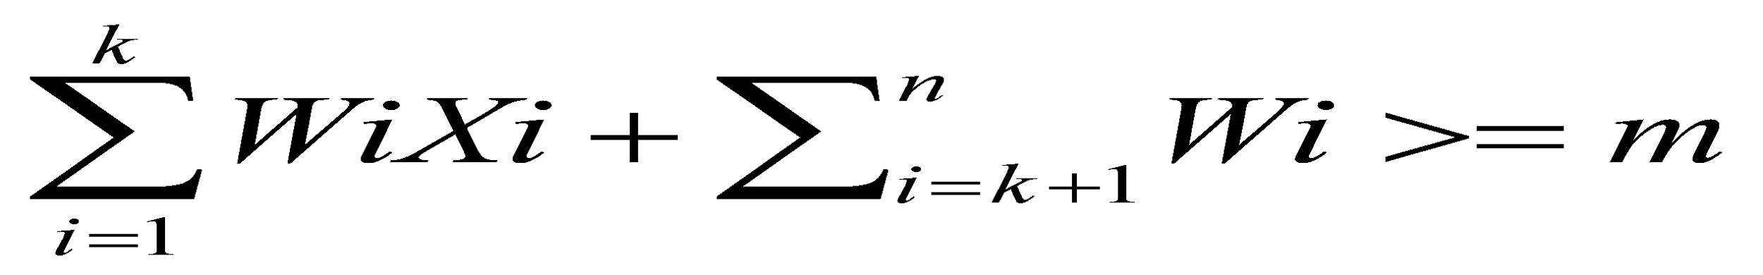
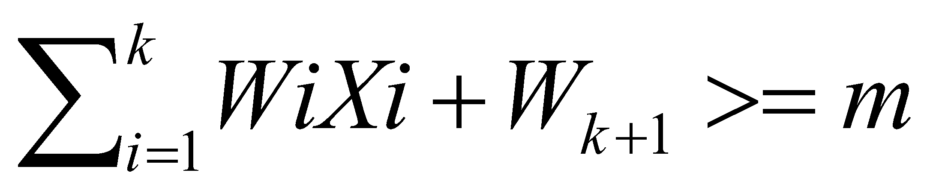
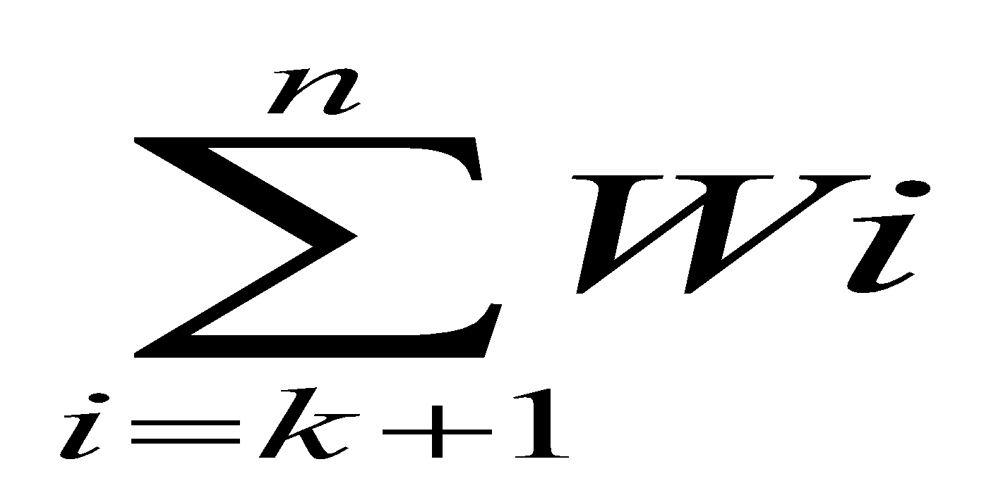
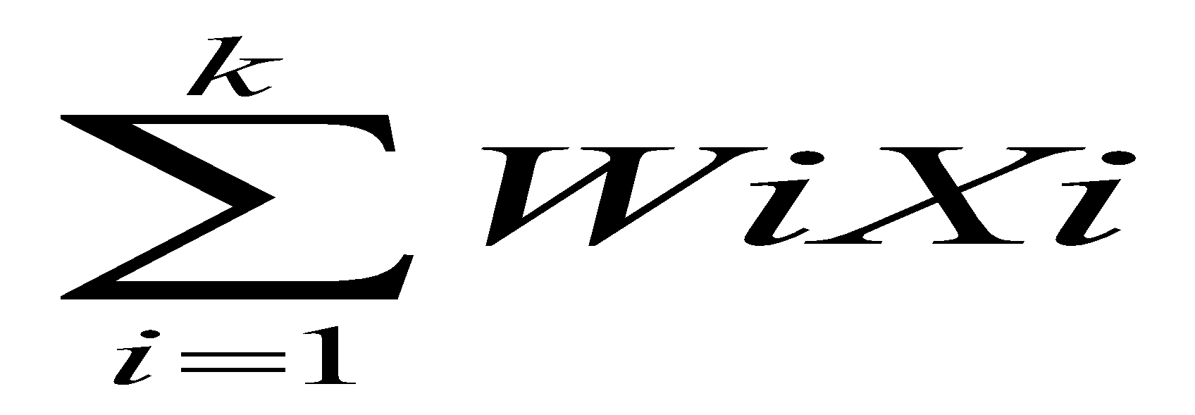
Bounding Function
* 2:15 AM Algorithm Analysis and Design
A node can lead to an answer state if
Bk is true iff
Computation of the sums and
each time when it is required, can be avoided by maintaining two sums s for current aggregate and r for remaining aggregate.

Slide 52
Algorithm
* 2:15 AM Algorithm Analysis and Design
Algorithm sumofsub(s,k,r)
{//generate left child with xk=1 fixed tuple formulation
x[k]:=1;
if (s+w[k]=m) then write (x[1:k]);
else if (s+w[k]+w[k+1]<=m)
then sumofsub(s+w[k],k+1,r-w[k]);
if ((s+r-w[k]>=m) and (s+w[k+1]<=m)) then
{x[k]:=0;
sumofsub(s,k+1,r-w[k]);}}

Slide 53
Terminology II
* 2:15 AM Algorithm Analysis and Design
Each non-leaf node in a tree is a parent of one or more other nodes (its children)
Each node in the tree, other than the root, has exactly one parent
parent
Usually, however, we draw our trees downward, with the root at the top
parent
children
children

Slide 54
E-node
1
X₁=1
2
X₂=1
X₁=2
3
6
X₁=3
X₃=1
4
5

